Slide 1
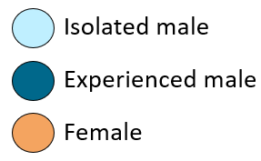
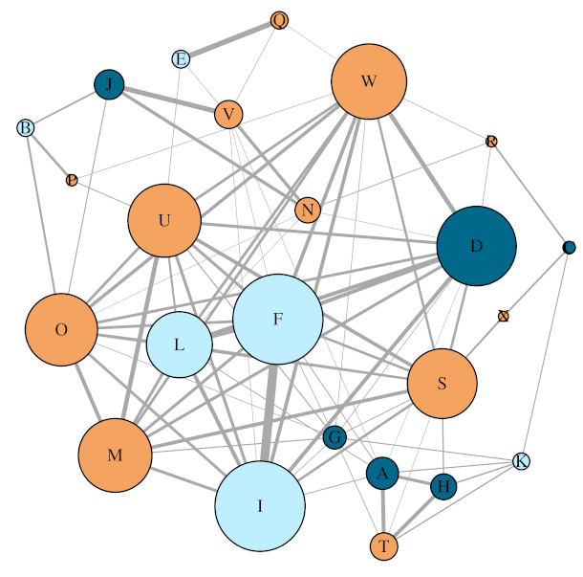
Replicate 1 aggregation network

Slide 2
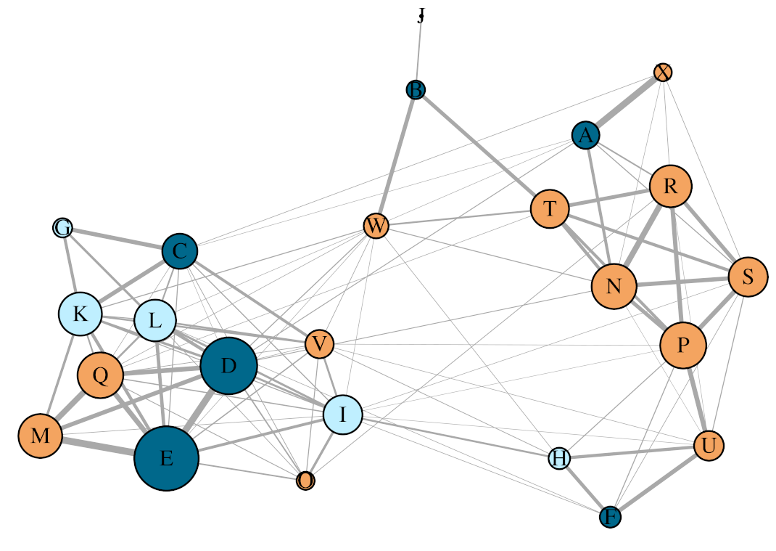
Replicate 2 aggregation network

Slide 3
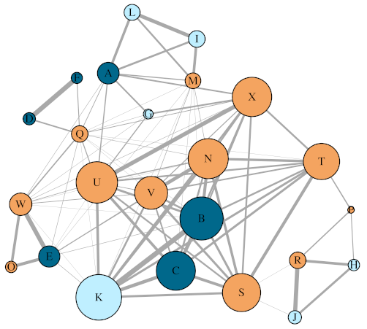
Replicate 3 aggregation network

Slide 4
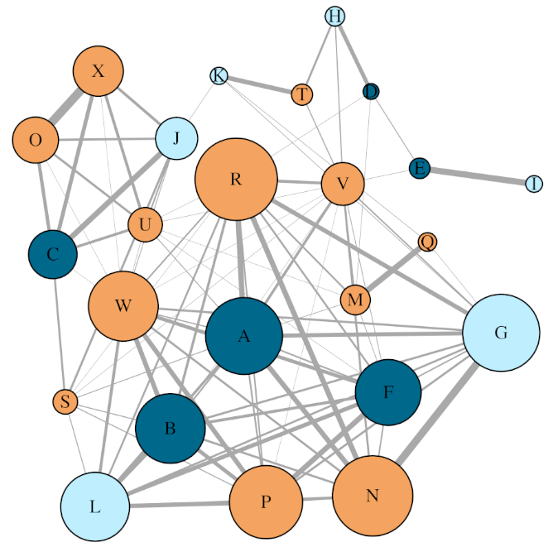
Replicate 4 aggregation network

Slide 5
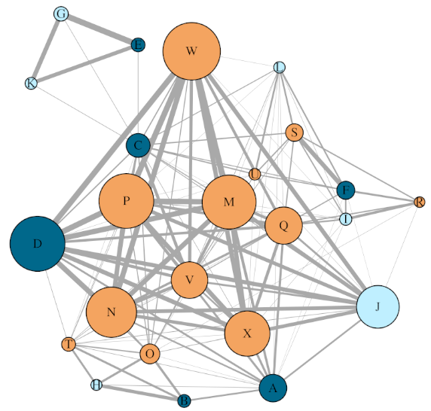
Replicate 6 aggregation network

